Slide 1

EditEdit MasterMaster texttext stylesstyles
Practical Lecture 1: Concepts & Basics of C++ Programming

Slide 2

Quick Recap
Let’s take a quick recap of previous lecture –
Basic data types
cin and cout
Derived data types ( Array, structure, union, enum, pointer)
Array / Structure
Union
Enum

Slide 3
Today’s Agenda
Today we are going to cover -
Coding Practice Question
MCQ Practice Questions
Theory Practice Question
Q&A Time

Slide 4
Problem
What types of errors do you encounter while executing C program?
Syntax errors
Logical errors
Runtime errors
1
2
3
All

Slide 5
solution
What types of errors do you encounter while executing C program?
Syntax errors
Logical errors
Runtime errors
1
2
3
All

Slide 6
Hint:Solution
Syntax Errors:
Errors in grammar of the language
Runtime error:
When there are no syntax errors, but the program can’t complete execution
Divide by zero
Invalid input data
Logical errors:
The program completes execution, but delivers incorrect results
Incorrect usage of parentheses

Slide 7
Problem
Which of the following is basic data type?
Int
Char
double
Float
1,2
1,2,4
All
1,2,3

Slide 8
Solution
Which of the following is basic data type?
Int
Char
double
Float
1,2
1,2,4
All
1,2,3

Slide 9
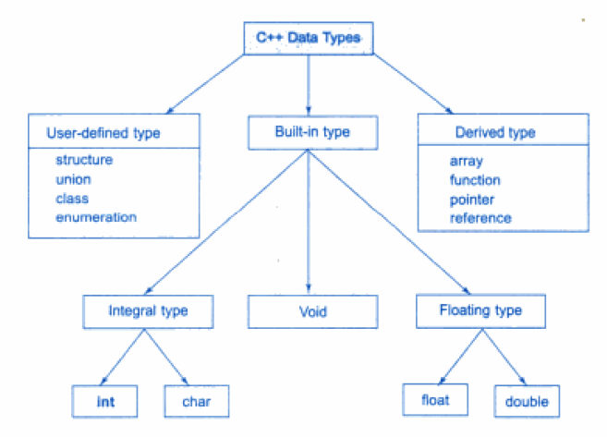
Solution

Slide 10
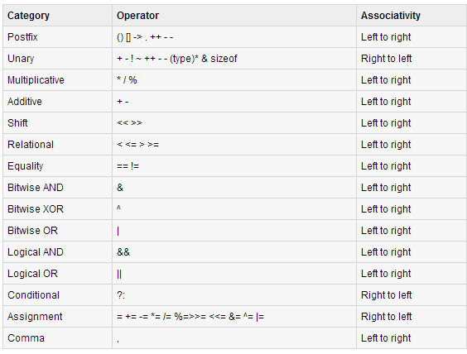
Operator precedence and associativity

Slide 11
Simple C++ program
C
/* my first program in C */
#include <stdio.h>
int main()
{
printf(“Welcome to C….\n");
return 0;
}
C++
/*my first program in C++*/
#include<iostream.h>
using namespace std;
int main()
{
cout<< “Welcome to C++…. \n”;
return 0;
}

Slide 12
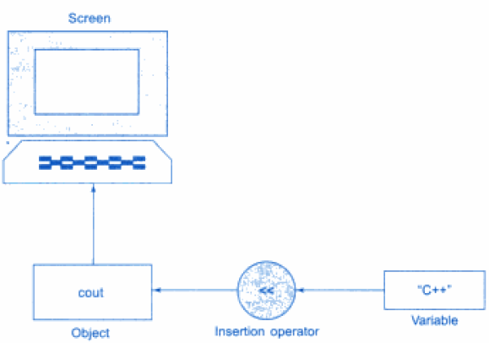
Output operator
The statement
cout<< “C++ is better than C. \n”;
The statement causes the string in quotation marks to be displayed on screen.

Slide 13
Question
How to display value of variable a in c++ like following?
Value of a = 5
Hint : In c , printf(“Value of a= %d” , a);

Slide 14
Solution
How to display value of variable a in c++ like following?
Value of a = 5
Hint : In c , printf(“Value of a= %d” , a);
cout<< “Value of a”<<a;

Slide 15
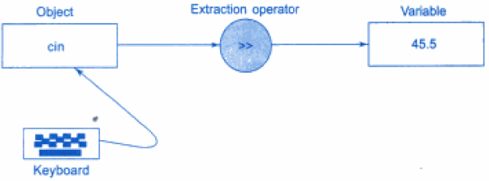
Input operator
The statement
cin>> number;
is an input statement and causes the program to wait for the user to type in a input.

Slide 16
Question
How to accept value of variables a,b from user in c++ like following?
Hint : In c , scanf(“%d%d” , &a, &b);

Slide 17
Solution
How to accept value of variables a,b from user in c++ like following?
Hint : In c , scanf(“%d%d” , &a, &b);
cin>>a>>b;

Slide 18
Control structures
One of the instructions, statements or groups of statements in a programming language which determines the sequence of execution of other instructions or statements is called control structure.
In C++ there are three Control Structures.
Sequence Structure (straight line)
Selection Structure (branching)
Loop Structure (iteration or repetition)

Slide 19
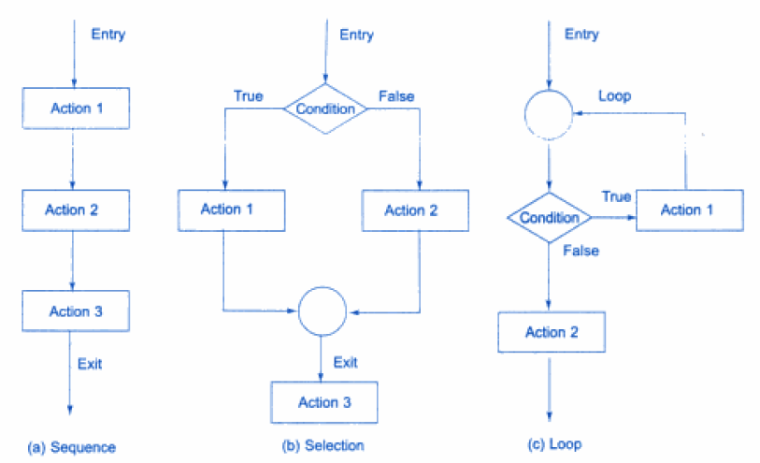
Control Structures

Slide 20
Problem
Which are the following are selection structures( branching)?
If
If else
Nested if
Switch
1,2
1,2,3
All
2,3,4

Slide 21
Solution
Which are the following are selection structures( branching)?
If
If else
Nested if
Switch
1,2
1,2,3
All
2,3,4

Slide 22
Selection Structure
C++ programming language provides following types of selection statements.
if statements
if .. else statements
Nested if statements
Learn Syntax
switch statements

Slide 23
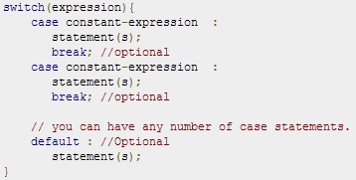
Selection Structure (Switch)
A switch statement allows a variable to be tested for equality against a list of values.
Each value is called a case, and the variable being switched on is checked for each case.
Syntax:

Slide 24
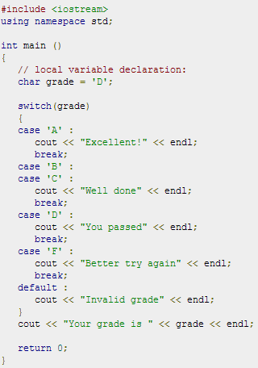
Problem

Slide 25
Problem
Which are the entry controlled loops in C?
For
while
Do..while
All
1 ,2
2,3
1,3

Slide 26
Solution
Which are the entry controlled loops in C?
For
while
Do..while
All
1 ,2
2,3
1,3

Slide 27
Solution
Which are the entry controlled loops in C?
For
while
Do..while
All
1 ,2
2,3
1,3

Slide 28
Program output?
#include <iostream>
using namespace std;
int main()
{
int a=10;
while(a>20)
{
cout<<"value of a: "<<a<<endl;
a++;
}
cout<<endl<<"end of program";
return 0;
}

Slide 29
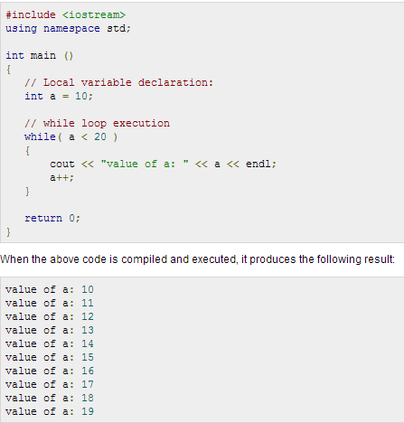
Program output

Slide 30
Program output?
#include <iostream>
using namespace std;
int main()
{
int a=10;
do
{
cout<<"value of a: "<<a<<endl;
a++;
}while(a>20);
cout<<endl<<"end of program";
return 0;
}

Slide 31
Program output

Slide 32
Program output?
#include <iostream>
using namespace std;
int main()
{
for( int a=10; a<20;a++)
{
cout<<"value of a: "<<a<<endl;
}
return 0;
}

Slide 33
Program output

Slide 34
Nested loops
#include <iostream>
using namespace std;
int main()
{
for( int a=1; a<5;a++)
{
for(int b=1;b<3;b++)
cout<<"value of a: "<<a<<" "<<b<<endl;
cout<<"value of b"<<b;
}
cout<<"value of b";
cout<<endl<<"end of program";
return 0;
}

Slide 35
Let’s have a quick hands-on some practice Questions
What will be the value of y after second statement is executed?
a=5,b=3,m=6;
y=a*++b/2+m%2

Slide 36
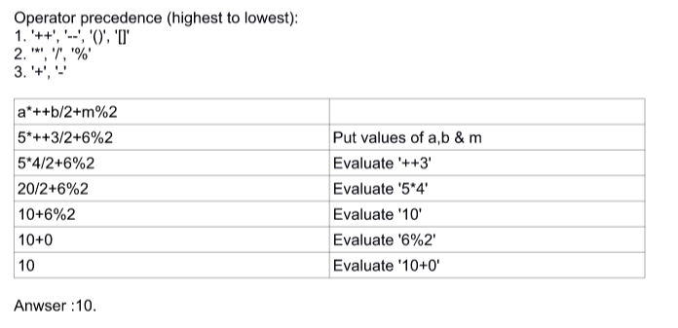
Solution:
What will be the value of y after second statement is executed?
a=5,b=3,m=6;
y=a*++b/2+m%2

Slide 37
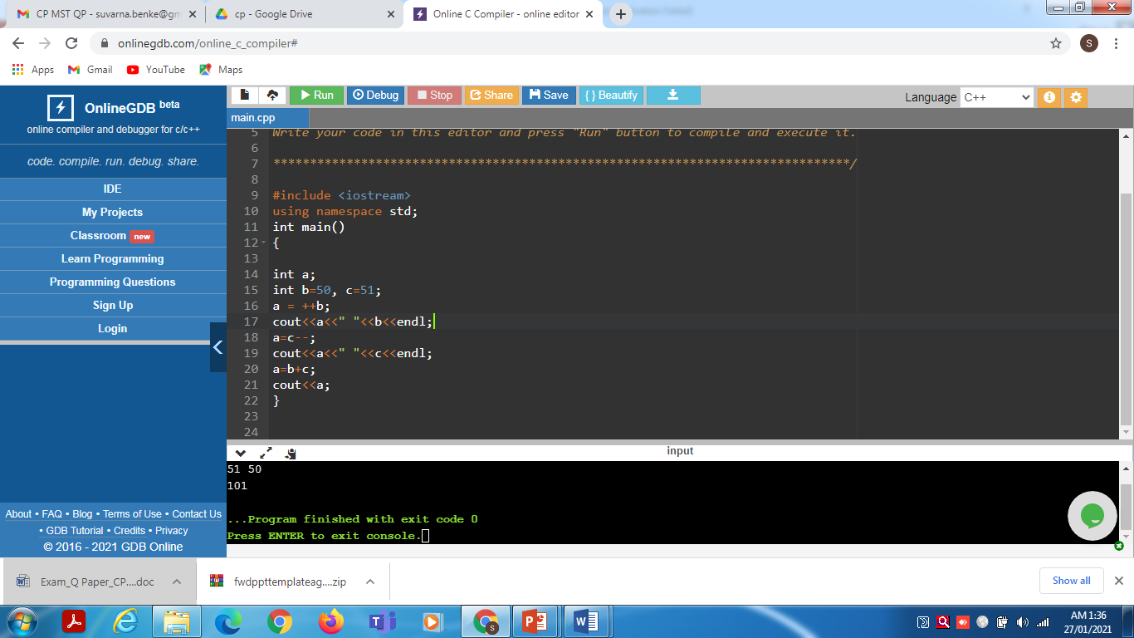
Predict the output!

Slide 38
Predict the output!
Output:
51 51
51 50
101

Slide 39
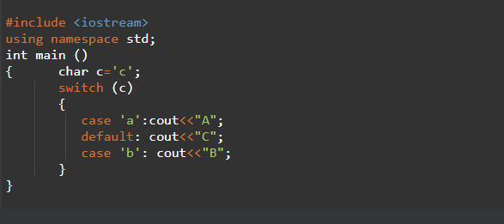
Predict the output!

Slide 40
Predict the output!
Output: CB

Slide 41
Predict the output!
#include <iostream>
using namespace std;
int main ()
{
int i=5;
while(i=5)
{
cout<<i<<endl;
i--;
}
}

Slide 42
structure
A structure is a group of dissimilar data elements grouped together under one name.
These data elements, known as members, can have different types and different lengths.

Slide 43
union
Unions allow one portion of memory to be accessed as different data types.
Its declaration and use is similar to the one of structures, but its functionality is totally different
The size of this type is the one of the largest member element.
Modification of one of the members will affect the value of all of them
It is not possible to store different values in them in a way that each is independent of the others.

Slide 44
enum
An enumeration is a user-defined data type that consists of integral constants.
It is mainly used to assign names to integral constants, the names make a program easy to read and maintain.
enum season { spring, summer, autumn, winter };
And, spring, summer and winter are values of type season.
By default, spring is 0, summer is 1 and so on.
You can change the default value of an enum element during declaration (if necessary).
enum season { spring = 0, summer = 4, autumn = 8, winter = 12 };

Slide 45
Function types
Built in
User defined
Ways to invoke function
1.accept input and return output
int sum(int , int );
2. accept input and no output
void sum (int , int);
3. no input and return output
int sum();
4. no input but no output
void sum();

Slide 46
MCQ Questions
Let’s Get Started-

Slide 47
Solution
5. The data elements in the structure are also known as what?
A.) objects
B.) members
C.) data
D) objects & data
Explanation: Variables declared inside a class are called as data elements or data members.

Slide 48
Problem - 6
6. What will happen when the structure is declared?
A.) it will not allocate any memory
B.) it will allocate the memory
C.) it will be declared and initialized
D) it will be declared

Slide 49
Solution
6. What will happen when the structure is declared?
A.) it will not allocate any memory
B.) it will allocate the memory
C.) it will be declared and initialized
D.) it will be declared
Explanation: While the structure is declared, it will not be initialized, So it will not allocate any memory

Slide 50
Problem-7
7. Which of the following is a properly defined structure?
A.) struct {int a;}
B.) struct a_struct {int a;}
C.) struct a_struct int a;
D.) struct a_struct {int a;};

Slide 51
Solution
7. Which of the following is a properly defined structure?
A.) struct {int a;}
B.) struct a_struct {int a;}
C.) struct a_struct int a;
D.) struct a_struct {int a;};
Explanation: option struct {int a;} is not correct because name of structure and ;(after declaration) are missing. In option struct a_struct {int a;} ; is missing. In option struct a_struct int a; {} are missing.

Slide 52
Let’s have a quick hands-on some practice Questions
Explain Procedural paradigms with example.
What do you understand by input and output stream.
What is structure explain with example.
What Union are important explain with example.
Explain Enumeration with example.

Slide 53
Coding Questions Time
1. Write a program in C++ to convert temperature in Celsius to Fahrenheit.
Sample Output:
Convert temperature in Celsius to Fahrenheit :
Input the temperature in Celsius : 35
The temperature in Celsius : 35
The temperature in Fahrenheit : 95

Slide 54
Coding Questions Time
2.Write a program to print all the prime number from 1-100.
3.Write a program to print the factorial of a number.
Input:-5
Output:-120
4.Write a C++ program to find LCM of two numbers using functions.

Slide 55
Coding Questions Time
6. An array stores details of 25 students (roll no, name, marks in three subject).
Write a program to create such an array and print out a list of students who have failed in more than one subject.

Slide 56

QNA Time
Any Questions??
Any Questions ??

Slide 57
Thank You!
See you guys in next class.

